Slide 1
Collaborative Filtering
(Latent Factor Models)
Group C

Slide 2
Outline
Overview of Recommender System
Problem Formulation
Latent Factors Model
Demonstration
Summary

Slide 3
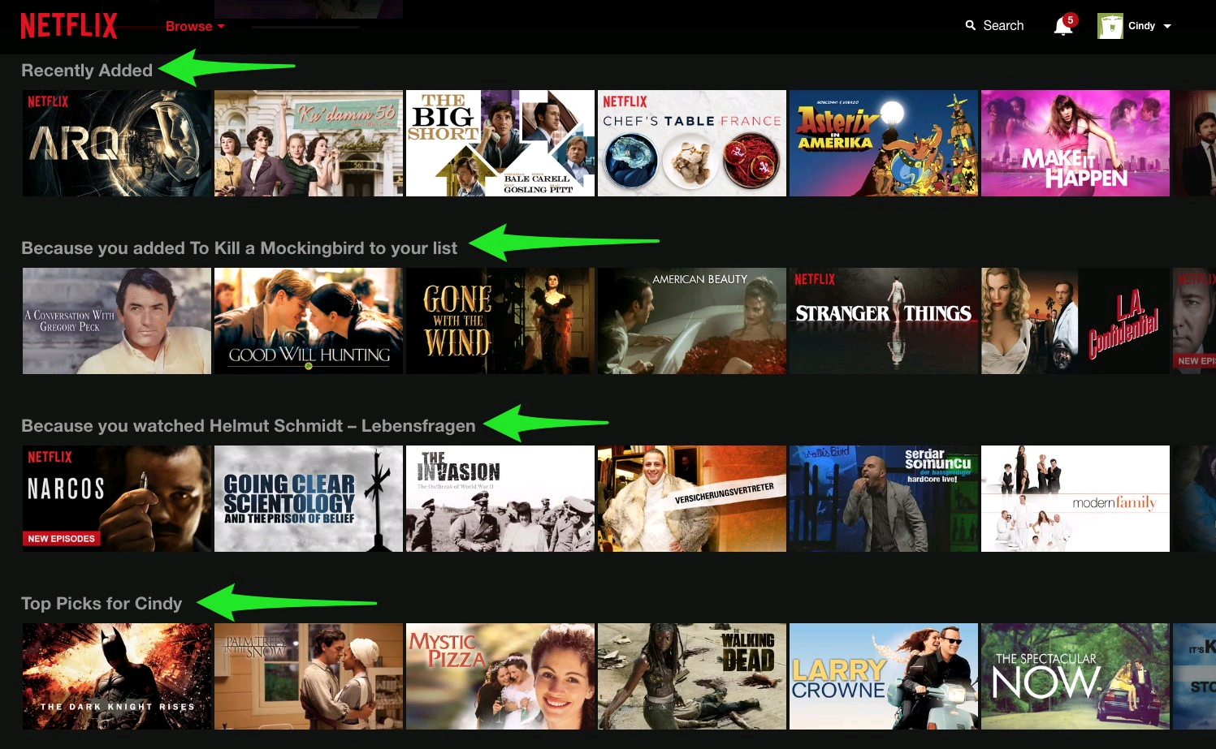
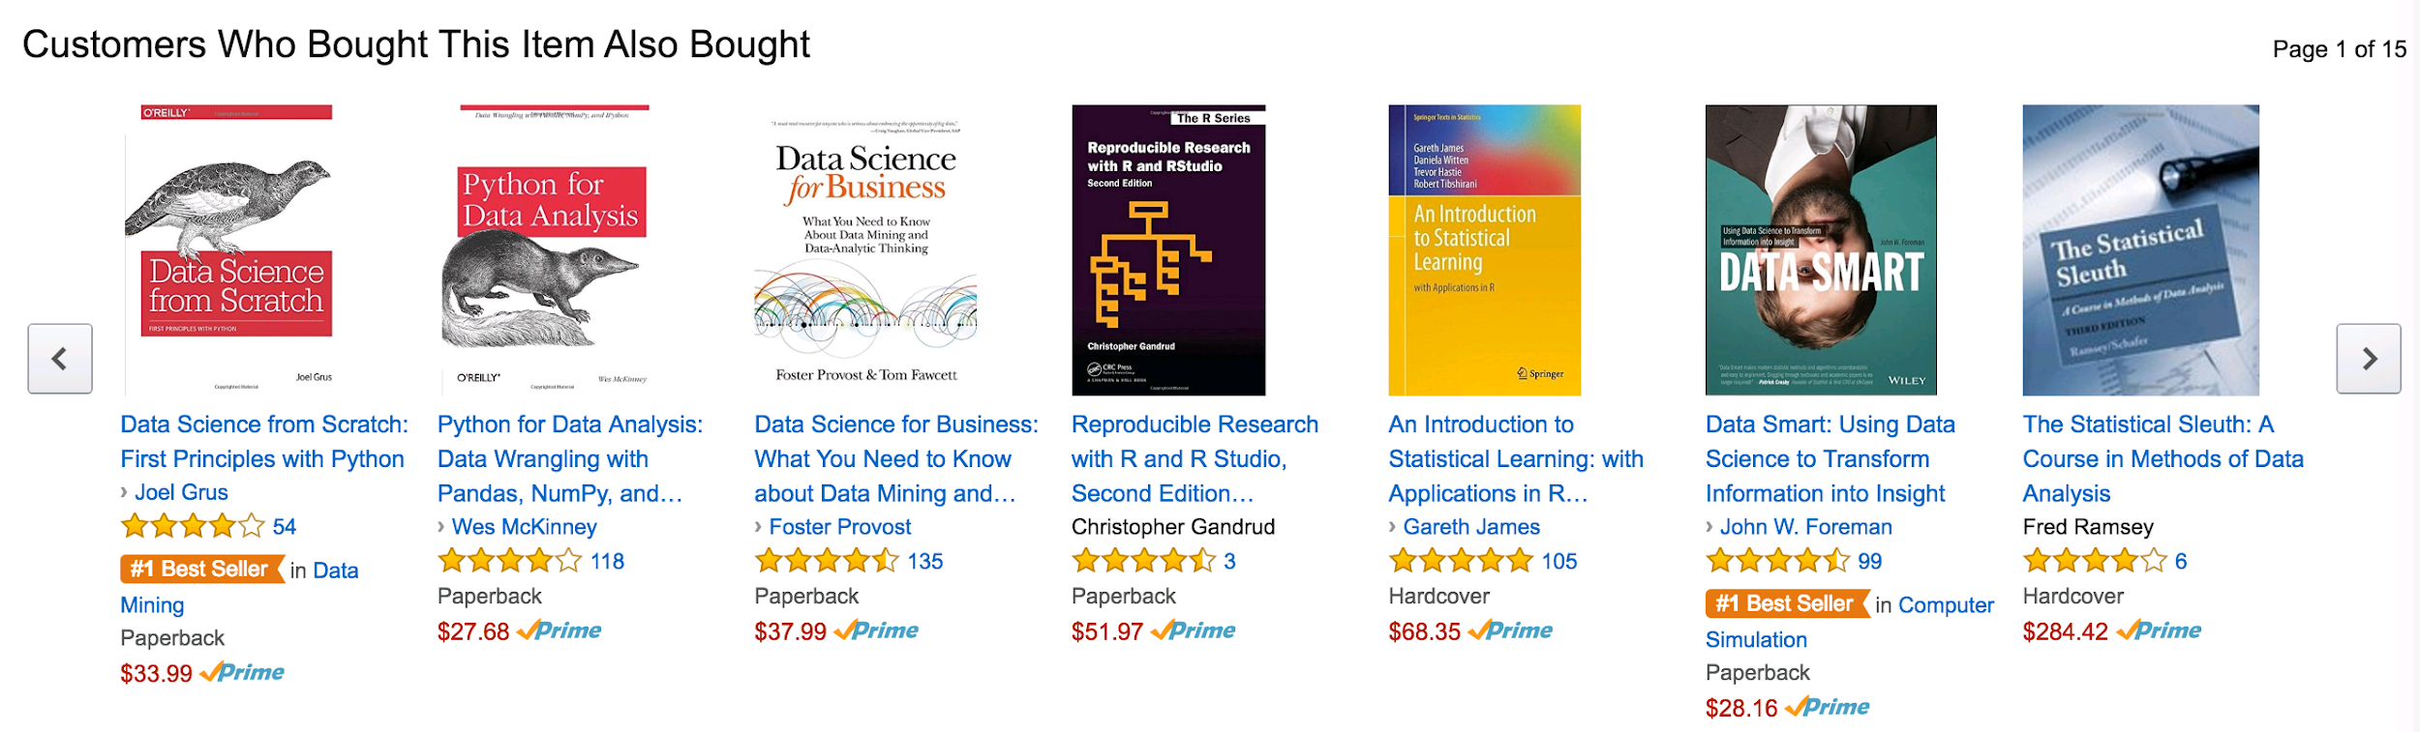
Recommender System
Predicting “preference” between user and item
Example: Online shop (Amazon, Taobao), Netflix, Facebook, Twitter

Slide 4
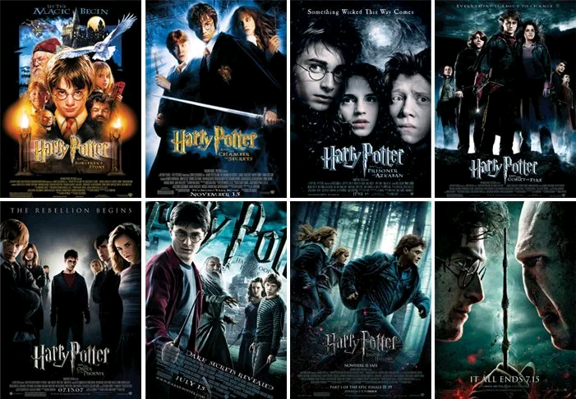
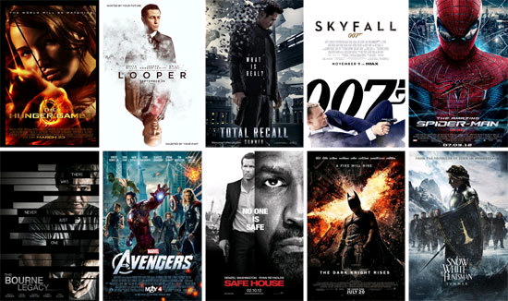
Approaches to Recommender System
Content-based Filtering
Based on feature of user or item
Collaborative Filtering
Based behaviour of user
Do NOT need to have feature of user or item

Slide 5
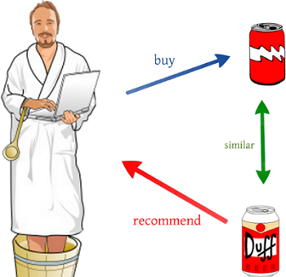
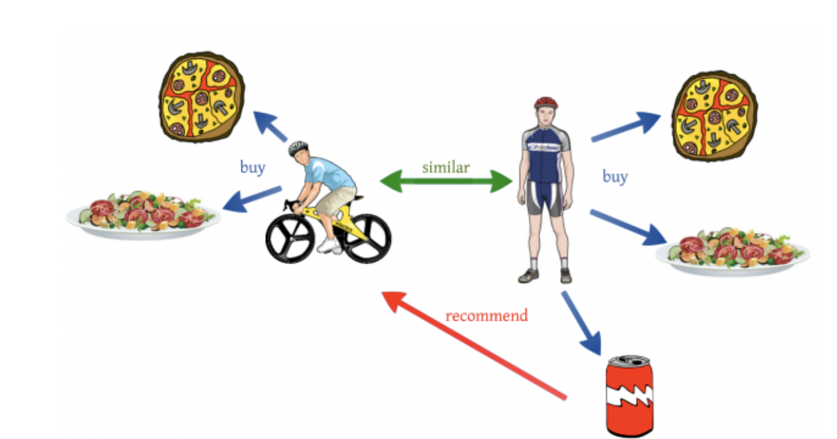
Collaborative Filtering (CF)
Memory-Based
Item-based: similarity among item
User-based: similarity among user
Model-Based
Latent Factor Models (Matrix Factorization)
Clustering Models
Bayesian Network
Principal Component Analysis (PCA)
Hybrid
Combination of memory-based and model-based

Slide 6
Collaborative Filtering (CF)
Advantages
Making use of other users’ experience can speed up the learning process.
Recommend items based on other users’ preference. Potential interest can be discovered.
Complicated concept like personal taste can be explored.

Slide 7
Collaborative Filtering (CF)
Drawback
Cold start (new user and new item)
Sparsity
The required calculation time increase as the number of users in the system increase
Low bias but high variance compare to content-based filter ⇒ suspicious to overfitting

Slide 8
Problem Formulation
For illustration, we will use movie recommendation system as an example.
Assume there are only m customers and n movies:
Question? How to fill the missing data and make recommendation to the user using latent factor model?
 | Movie A | Movie B | Movie C | …... | Movie n
Customer 1 | 5 | 5 | 1 | …... | 4
Customer 2 | 5 | ? | ? | …... | 3
Customer 3 | ? | 2 | 5 | …... | ?
…... | …... | …... | …... | …... | 1
Customer m | 1 | ? | 2 | …... | ?

Slide 9
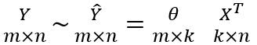
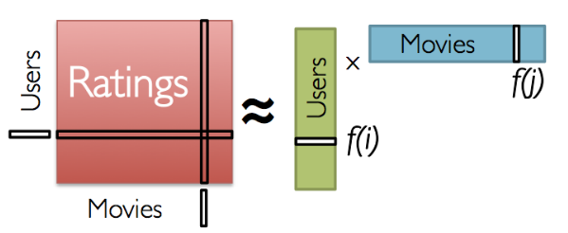
Latent Factor Model (Matrix Factorization)
Model each user/item as a vector of latent (hidden) factors (k)
m: number of users
n: number of movies
k: number of latent factors, where k << m, n
The rating matrix Y can be approximate as:

Slide 10
Latent Factor Model (Matrix Factorization)
Number of users | m
Number of movies | n
True rating matrix | Y (m x n)
Predicted rating matrix | Y_hat (m x n)
Number of latent factors | k
User factor matrix | Theta (m x k)
Movie factor matrix | X (n x k)

Slide 11
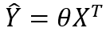
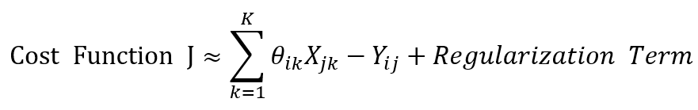
Latent Factor Model (Matrix Factorization)
Step 1: Randomly initialize the parameters Theta and X
Step 2: Calculate the prediction Y_hat by compute the dot product of Theta and the transpose of X
Step 3: Define a cost function based on the difference between Y and Y_hat
Step 4: Minimize the cost function using gradient descent
Step 5: Make recommendation to the users using the prediction matrix Y_hat

Slide 12
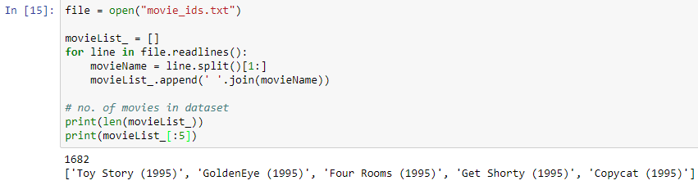
Demonstration: Loading Data (1)

Slide 13
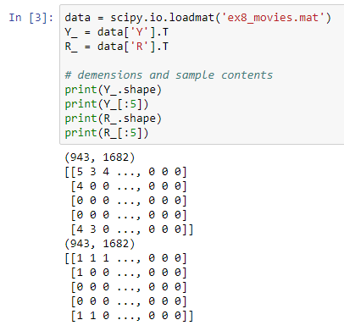
Demonstration: Loading Data (2)
Y = R(943x1682) {0, 1, 2, 3, 4, 5}
Users Preference on the Movies
R = R(943x1682) {0, 1}
Whether Users rated the Movies

Slide 14
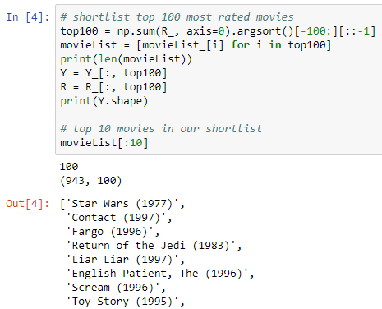
Demonstration: Data Pre-processing (1)
Shortlist the top 100 movies with the most rating activities
Movies are from 60’s to 90’s

Slide 15
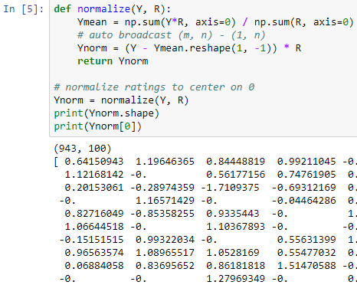
Demonstration: Data Pre-processing (2)
We want an average score for movies that have not been seen or rated by users.
Ymean is the mean for each movies

Slide 16
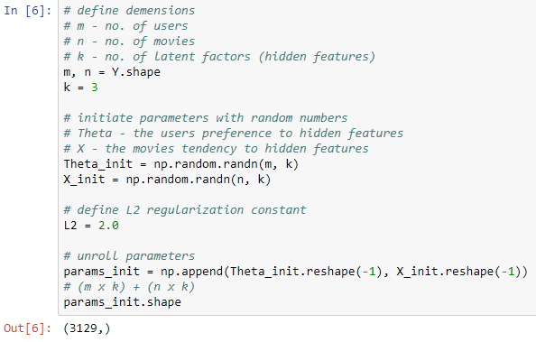
Demonstration: Parameters Initiation
We don’t have to know in advance what the 3 latent factors are.
Theta.dot(X.T) = Y_hat

Slide 17
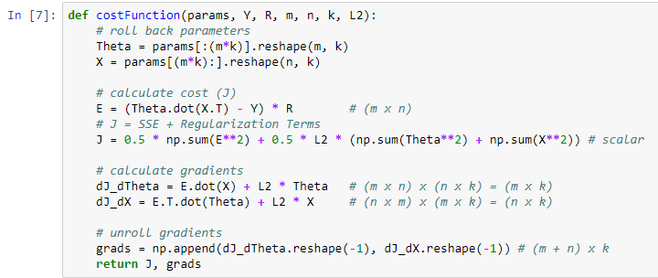
Demonstration: The Cost Function

Slide 18
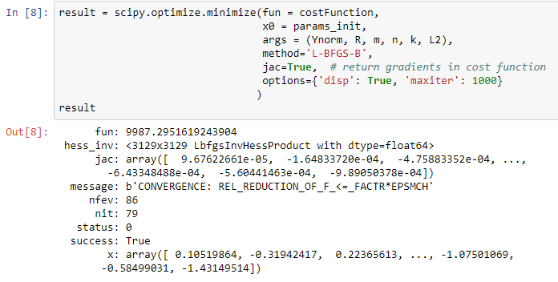
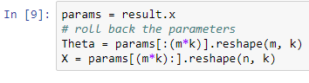
Demonstration: SciPy Optimizer

Slide 19
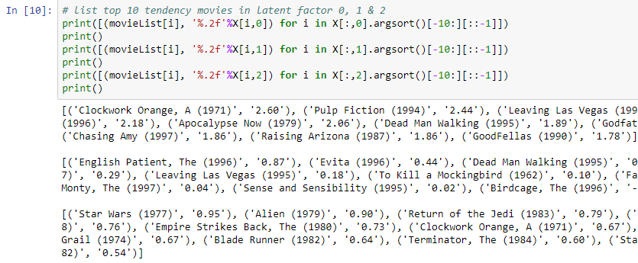
Demonstration: Latent Factors Analysis

Slide 20



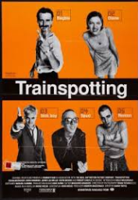
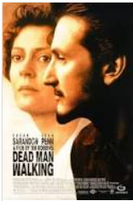

Demonstration: Latent Factors (1)
Which Types have High Score?
Criminals
Violence
Drugs Taking

Slide 21

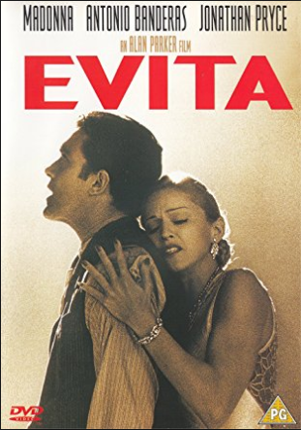
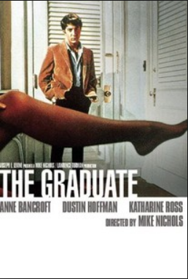
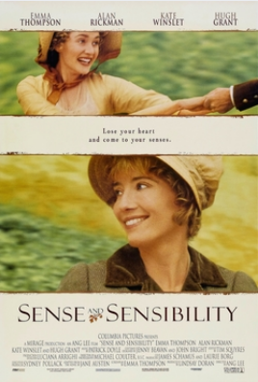
Demonstration: Latent Factors (2)
Which Types have High Score?
Feminanine
Romance
Musical

Slide 22
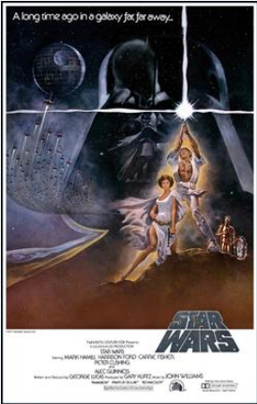





Demonstration: Latent Factors (3)
Which Types have High Score?
Commercial
Sci-fi
Action

Slide 23
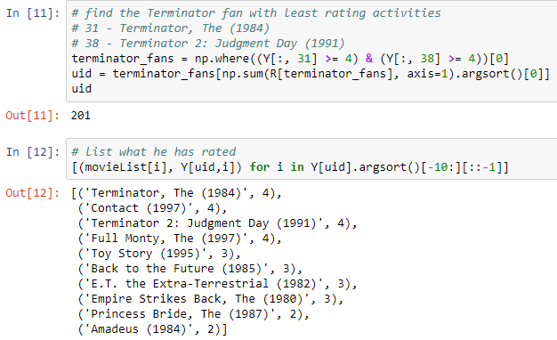

Demonstration: Movies Recommendation

Slide 24
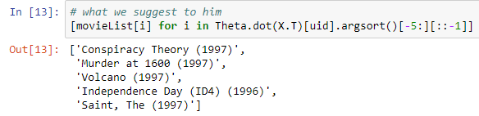
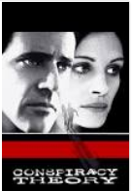



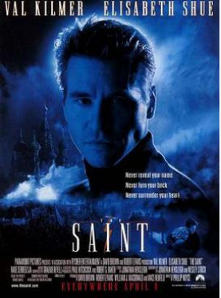
Demonstration: Movies Recommendation

Slide 25
Summary
In this presentation, these should be your takeaways:
Have an idea in the big picture of collaborative filtering.
The concepts of latent factors method in collaborative filtering.
Acknowledged how to apply collaborative filtering to recommend movies.

Slide 26
Reference (1)
https://arxiv.org/ftp/arxiv/papers/1503/1503.07475.pdf
http://www.bigdatafinance.tw/index.php/379-2017-05-10-08-05-49
http://dsec.pku.edu.cn/~jinlong/publication/wjlthesisppt.pdf
http://augus-blog.logdown.com/posts/143404-mahout-tutor-1
https://www.quora.com/What-is-the-difference-between-content-based-filtering-and-collaborative-filtering
http://www.ideal.ece.utexas.edu/seminar/LatentFactorModels.pdf

Slide 27
Reference (2)
https://www.coursera.org/learn/machine-learning
https://hackernoon.com/introduction-to-recommender-system-part-1-collaborative-filtering-singular-value-decomposition-44c9659c5e75

Slide 28
Q&A

Slide 29


Links to the External Resources
Youtube
https://youtu.be/w2QQPuzeqmI
GitHub
https://github.com/kenchan0824/hku-comp7404-project

